Slide 1
Intro to Next Generation Sequencing Data Analysis with Galaxy
While we are waiting:
Connect to Tufts network (on campus or VPN)
Chrome browser https://galaxy.cluster.tufts.edu
Login with Tufts credentials
Let me know if you have trouble logging in
Rebecca Batorsky
Pr Bioinformatics Scientist
Nov 2021

Slide 2

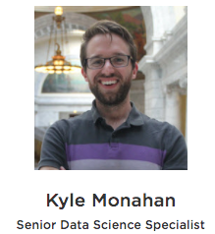

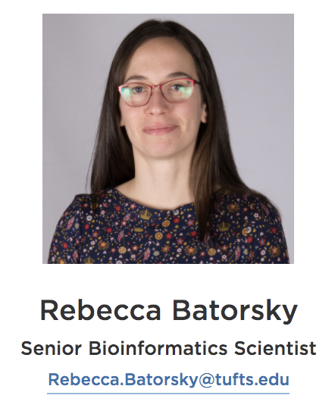
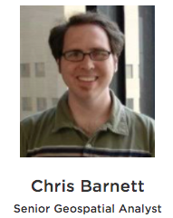
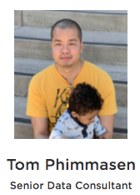
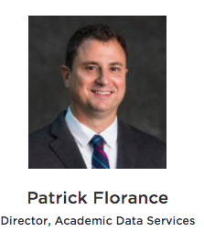


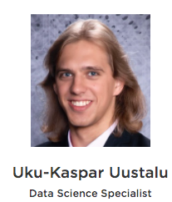
Research Technology Team
Consultation on Projects and Grants
High Performance Compute Cluster
Workshops
https://it.tufts.edu/research-technology

Slide 3
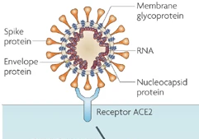
SARS-CoV2 Spike Protein
Host cell Receptor ACE2
https://www.nature.com/articles/nrmicro2090
Notes:
Severe acute respiratory syndrome-coronavirus (SARS-CoV) has an RNA genome, which encodes proteins necessary for it’s replication inside cells. The genome is contained in an envelope, which is studded with envelope and Spike proteins. It enters host cells when the receptor binding domain of the Spike protein binds to the host cell receptor angiotensin-converting enzyme 2 (ACE2)¹²⁹, and the ACE2–virus complex enters the cell where downstream steps in the virus lifecycle take place.
Viruses have a high mutation rate, and not surprisingly the Spike protein is under selective pressure to change the receptor binding domain in order to more readily infect cells.

Slide 4

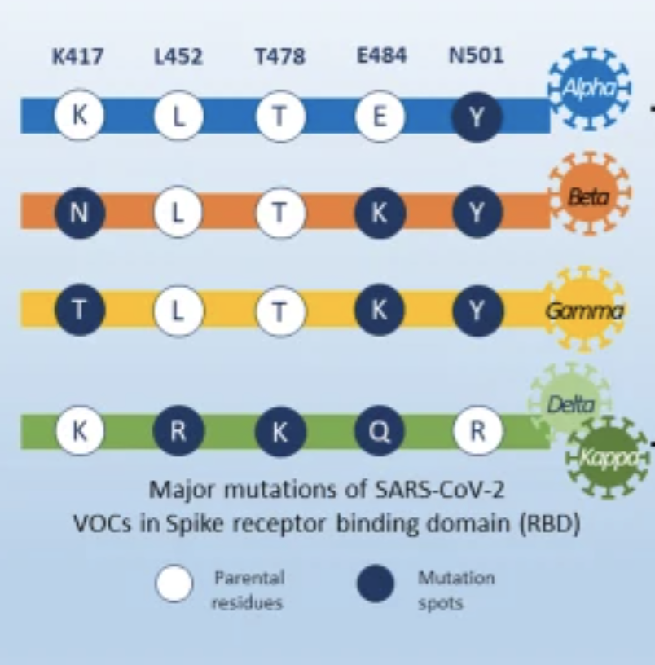
SARS-CoV2 Spike Protein VOCs
Spike protein
Increase
ACE2 affinity
Transmissibility
https://ccforum.biomedcentral.com/articles/10.1186/s13054-021-03662-x
Notes:
As we have probably all heard there are several varaints of the originally charachterized sars cov 2 sequence that are circulating at high levels around the world.They contain 5 major mutations with respect to the original sequence, shown here. For example take L452, which is spike protein residue number 452 which is lysine in the original sequence, and changes to argenine in the delta variant. These mutations in the spike proteins have been shown to result in higher ACE2 affinity, transmissibility among other phenotypes that make them an increased thread to public health.
Today, we’ll study a delta variant sample and compare these positions to the originally characterized sequence using bioinformatics methods.

Slide 5
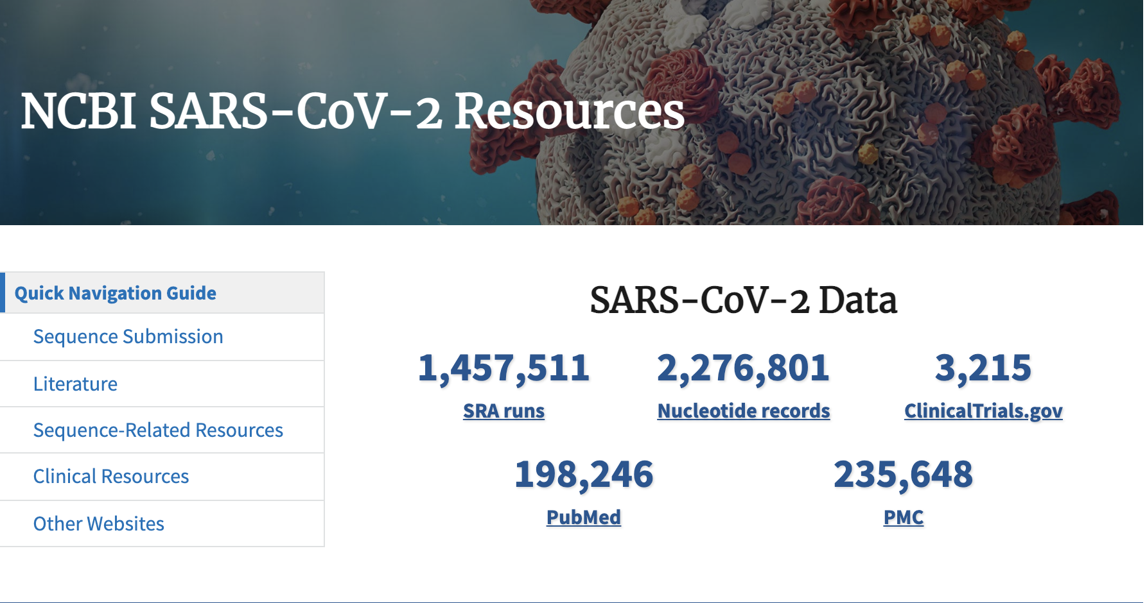
https://www.ncbi.nlm.nih.gov/sars-cov-2/
Notes:
The US National Center for Biotechnology Information hosts repositories for many types of biomedical and genomics data. Today we'll retrieve reference data from Nucleotide repository, which contains among other things sequence records for SARS-CoV2 genomes as well as the Sequence Read Archive (SRA) where raw next generation sequencing data can be easily obtained for reanalysis.

Slide 6
Outline
Introduction to the Galaxy Platform
Obtain data from NCBI
SARS-Cov-2 Alpha variant reference sequence
SARS-Cov-2 Delta variant NGS sample
Process Raw Reads (QC, adapter trimming)
Align Reads
Visualize
Verify delta variant mutations relative to ancestral sequence

Slide 7
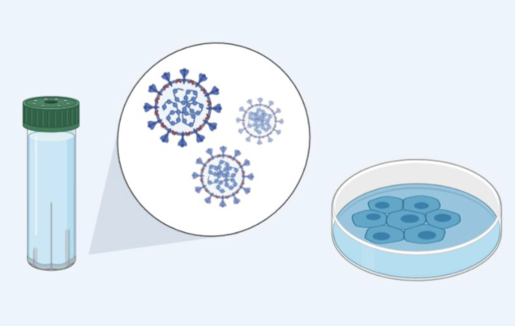

Viral Genome Next Generation Sequencing (NGS)
Specimen Collected
NGS reads
Notes:
The process starts with a clinical sample collection, for respiratory viruses this is usually a nasal swab.
Then, total RNA is extracted from the sample, this contains both virus and host RNA.
At this point a decision is made about downstream protocol based on whether the virus is known.
In the case we will study, the authors are interested in sequencing SARS-CoV-2 which has a known sequence, so they can design virus specific primers which will capture SARS-CoV2 and not the host RNA, and transcribe it into complementary DNA which can be prepped for sequencing.
Importantly, the primers they design will limit what they capture, so they must design the primers to bind in regions that they expect are conserved between viral variants.
An amplification procedure has to be performed, because the current NGS technologies require a high input DNA amount and the viral genome amount is several orders of magnitude lower.
Then, the preparation for NGS sequencing begins.
We start with viral cRNA fragments that can be sequenced the same as DNA on an NGS sequencer.
Sequencing adapters are added (these are the blue rectangles) that will allow the cDNA fragments to attach to the sequencing flowcell.
I won’t go in depth through the sequencing process, but the sequence of the fragments is determined using fluorescently tagged nucleotides that emit a colored light signal when they attach to a base on the fragment being sequences. It is the optical signal that the instrument reads to determine which base in the sequence was read.

Slide 8
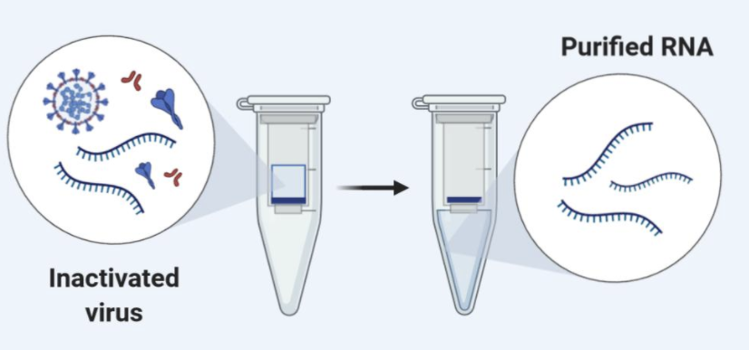
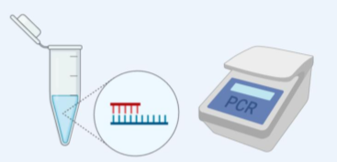
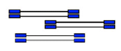
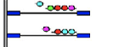

Viral Genome Next Generation Sequencing (NGS)
cDNA synthesis (using virus-specific primers)
Amplification
Specimen Collected
RNA extraction
NGS library prep
NGS sequencing
Alignment
flowcell
Notes:
The process starts with a clinical sample collection, for respiratory viruses this is usually a nasal swab.
Then, total RNA is extracted from the sample, this contains both virus and host RNA.
At this point a decision is made about downstream protocol based on whether the virus is known.
In the case we will study, the authors are interested in sequencing SARS-CoV-2 which has a known sequence, so they can design virus specific primers which will capture SARS-CoV2 and not the host RNA, and transcribe it into complementary DNA which can be prepped for sequencing.
Importantly, the primers they design will limit what they capture, so they must design the primers to bind in regions that they expect are conserved between viral variants.
An amplification procedure has to be performed, because the current NGS technologies require a high input DNA amount and the viral genome amount is several orders of magnitude lower.
Then, the preparation for NGS sequencing begins.
We start with viral cRNA fragments that can be sequenced the same as DNA on an NGS sequencer.
Sequencing adapters are added (these are the blue rectangles) that will allow the cDNA fragments to attach to the sequencing flowcell.
I won’t go in depth through the sequencing process, but the sequence of the fragments is determined using fluorescently tagged nucleotides that emit a colored light signal when they attach to a base on the fragment being sequences. It is the optical signal that the instrument reads to determine which base in the sequence was read.

Slide 9
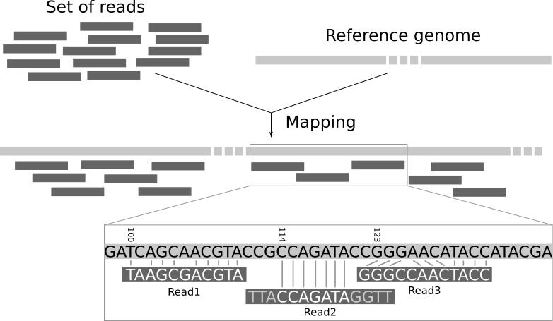
Short Read Alignment
Notes:
Here is a high level description of the mapping process. The input consists of a set of reads and a reference genome. In the middle, it gives the results of mapping: the locations of the reads on the reference genome. The first read is aligned at position 100 and the alignment has two mismatches. The second read is aligned at position 114. It is a local alignment with clippings on the left and right. The third read is aligned at position 123. It consists of a 2-base insertion and a 1-base deletion.

Slide 10
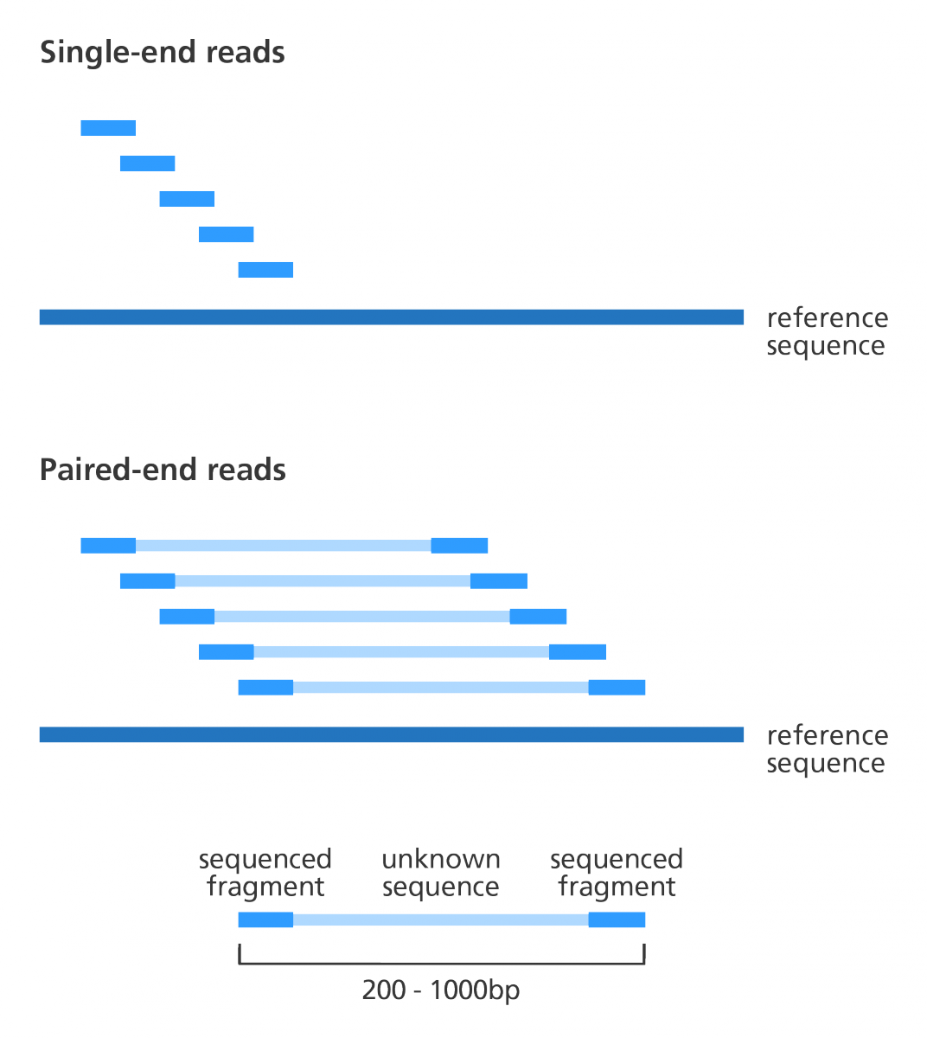
Paired end vs Single end reads
cDNA fragment
https://www.biostars.org/p/267167/
Notes:
NGS sequencing can generate single end reads and paired end reads, our sample today consists of paired end reads.
The basic difference is that for single end reads, one side of the cDNA fragment is sequenced, with paired end sequencing, the fragment is flipped over on the flowcell so that both sides of the fragment can be sequenced.
Thus, two reads “paired” are generated from each side of the fragment. They may not cover the entire fragment.
Paired read sequencing typically gives more accurate sequencing information for each sequenced fragment, both because fragments are sequenced in two directions, and because it’s possible to link sequence fragments that are at some distance from each others. This is especially useful in virus samples, where different viral variants may be present in the same sample.

Slide 11
Outline
Introduction to the Galaxy Platform
Obtain data from NCBI
Process Raw Reads (QC, adapter trimming)
Read Alignment
Visualization

Slide 12
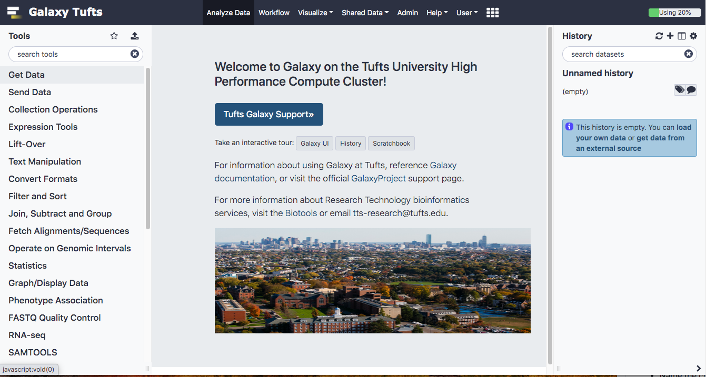
Log into Galaxy
Connect to Tufts Network, either on campus or via VPN
Visit https://galaxy.cluster.tufts.edu
Log in with you Tufts credentials

Slide 13

Galaxy on the Tufts High Performance Compute (HPC) Cluster
HPC Cluster
node | node | node | node
node | node | node | node
User laptop
Proxy web-server
(Apache)
Job scheduler
(SLURM)
PAM Authentication
PostgreSQL Database server
Galaxy web-server
Notes:
Our Galaxy server runs on the HPC cluster, storing data on HPC drives and using compute nodes and Slurm scheduler to run user jobs
In practice, this means that Tufts users have more resources on Tufts’ Galaxy compared to public servers
We also have the ability to install and configure open source and custom tools
More information on getting access to Tufts Galaxy can be found on the Research Technology website

Slide 14
User Interface
Notes:
We’ll spend some time getting familiar with the Galaxy interface, layout, and key functions

Slide 15
User Interface
TOP MENU BAR
TOOLS
HISTORY
MAIN
Notes:
The Galaxy User Interface has a top menu bar and three panels: Tools, Main, and History

Slide 16
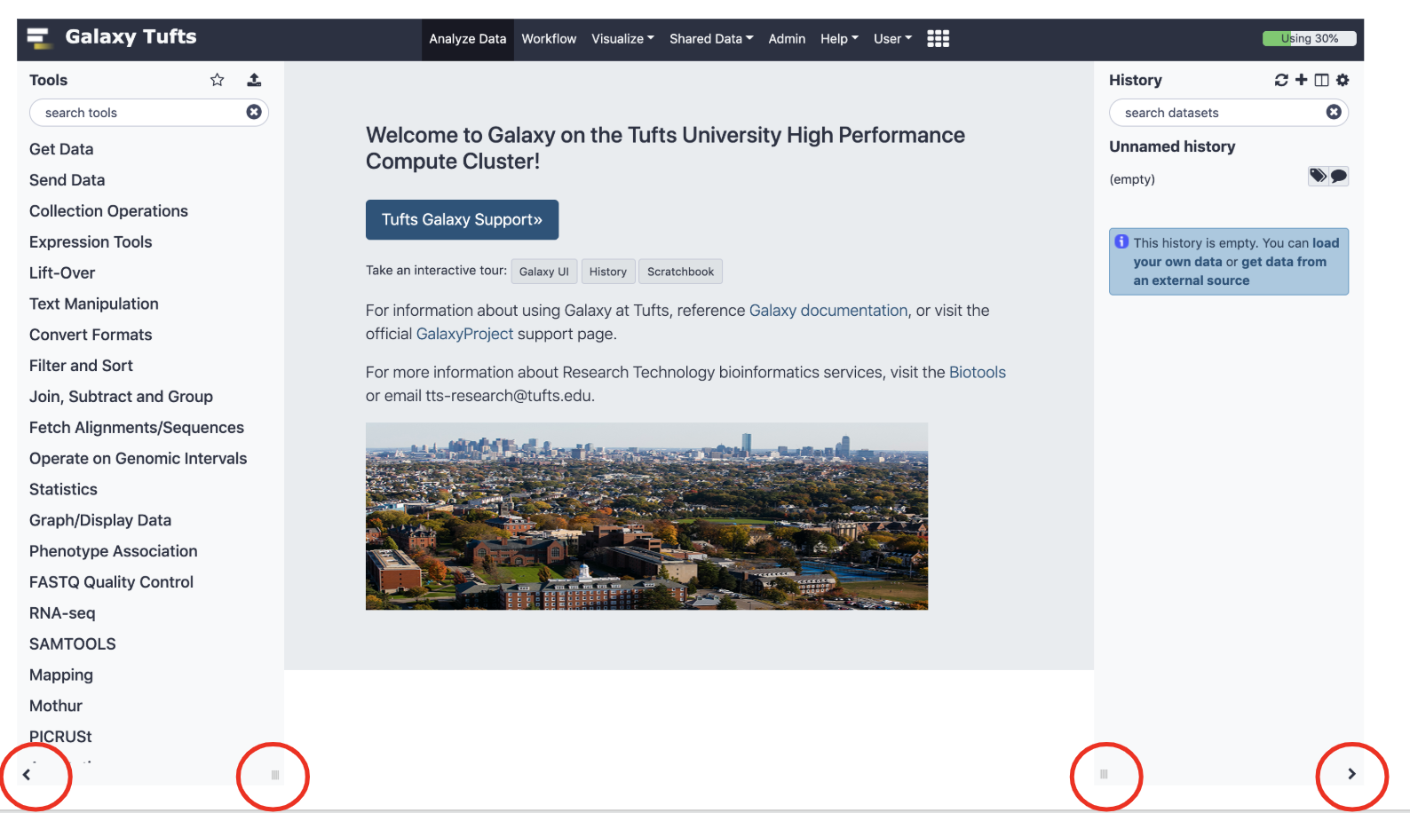
Galaxy User Interface
To return to home screen
Minimize/Adjust toolbars
Notes:
The panels can be expanded/minimized using the small arrows and dragging the three small lines in the bottom left and right corners of the page
To get back to the home page click the logo next to Galaxy Tufts on the top left of the page or the Analyze Data tab on the top of the page

Slide 17
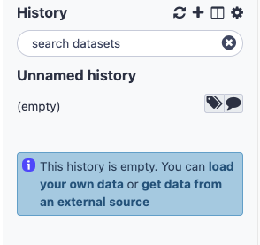
History
Create New History
View all Histories
Notes:
Histories are where a dataset and a set of analysis are stored
Similar to a “working directory”.
You can have multiple histories under the same account and you can view them all by clicking the + as shown below

Slide 18
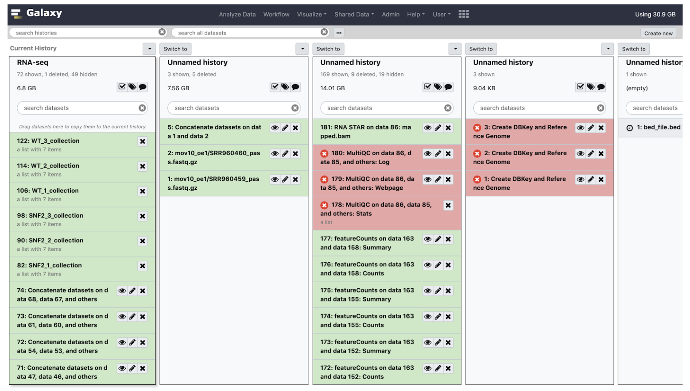
History
Create New History
View all Histories
Notes:
Histories are where a dataset and a set of analysis are stored
Similar to a “working directory”.
You can have multiple histories under the same account and you can view them all by clicking the + as shown below

Slide 19
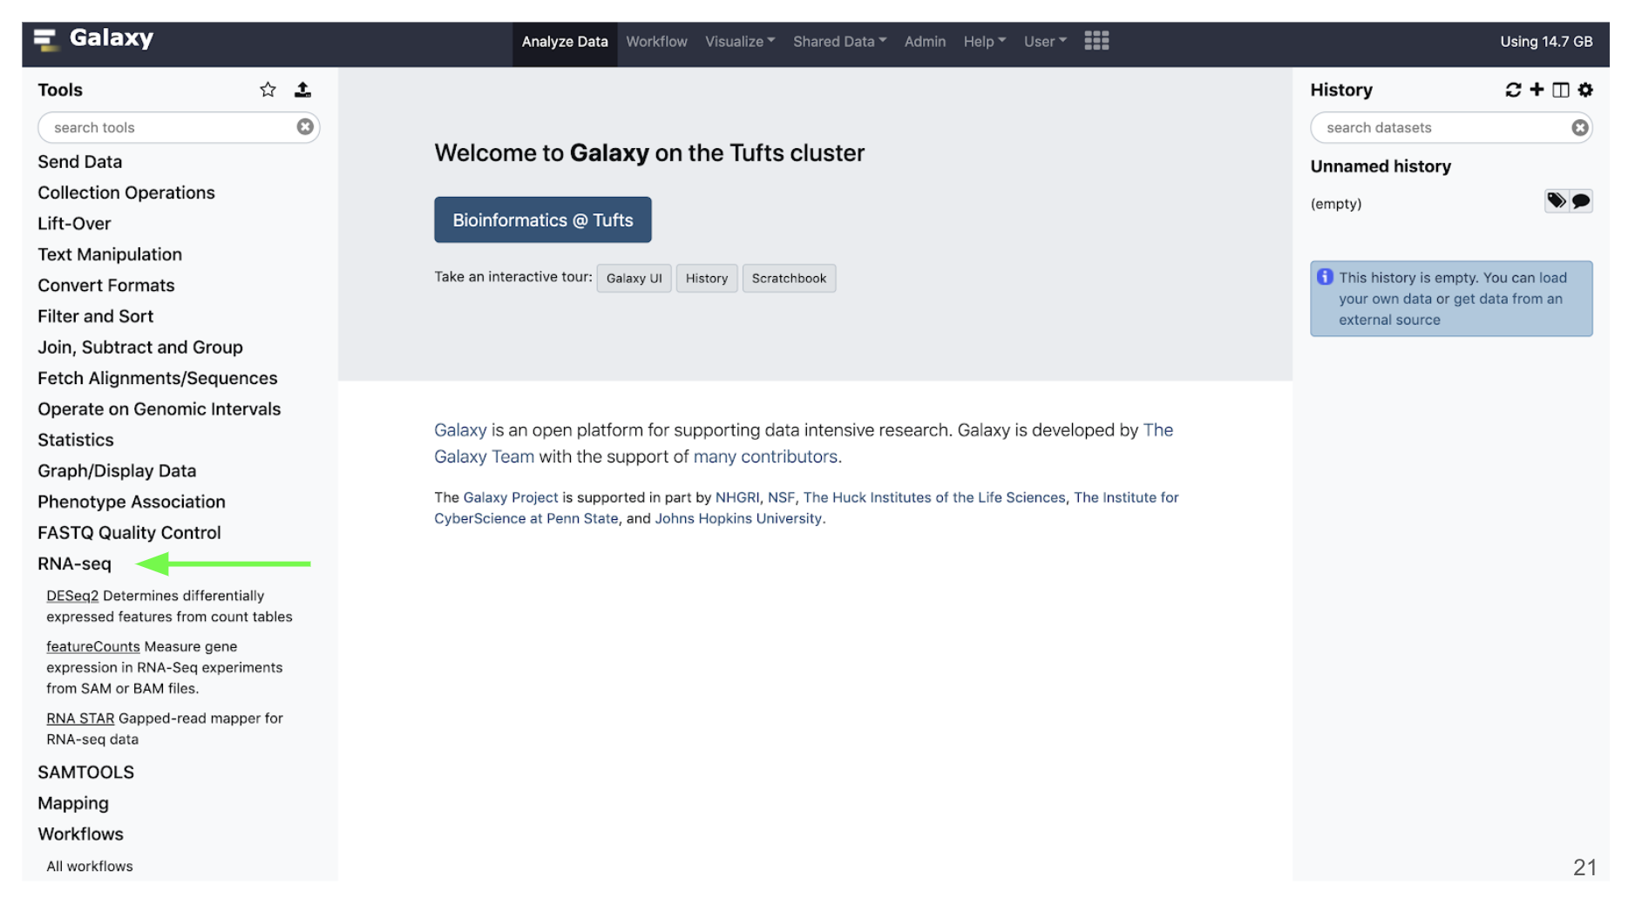
Tools
Notes:
On the Tools panel, either search by name or click the category that your tool would fall under
For example for RNAseq analysis, they will be stored under the RNA-seq category
Tools for alignment will be under the Mapping category

Slide 20
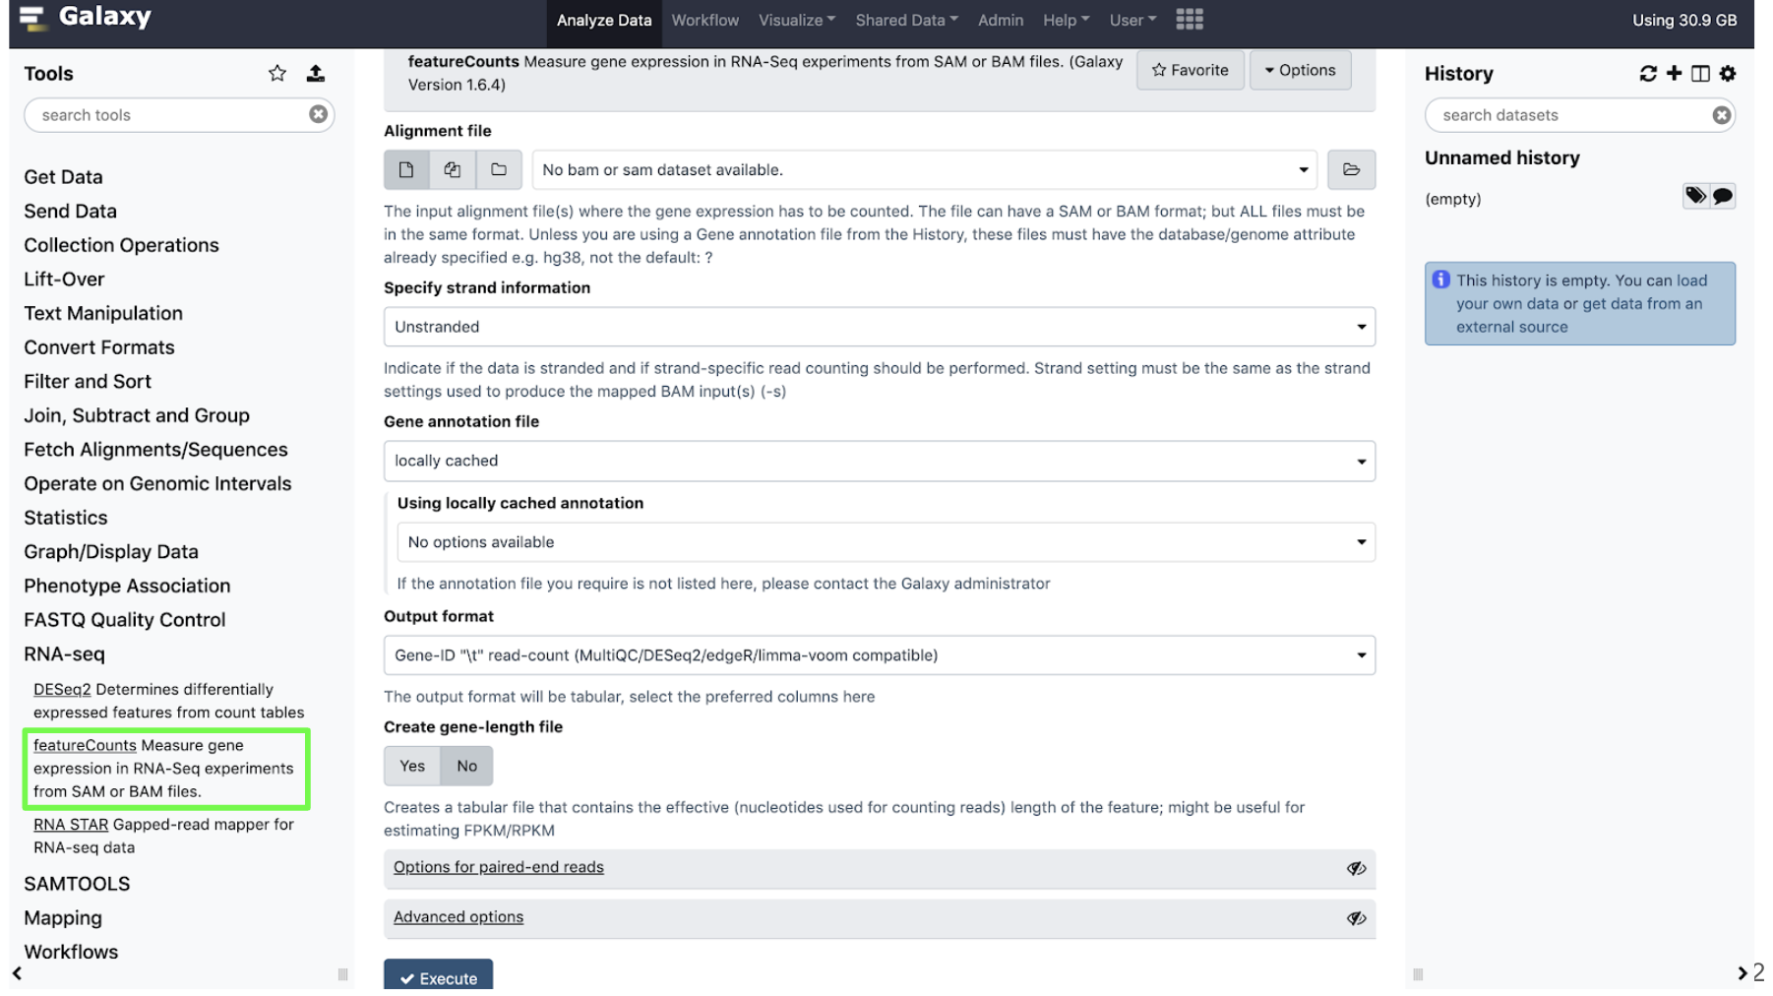
Tools
Click on the name of the tool
to open it in the main panel
Notes:
Click the name of the tool you would like to use and the tool menu will appear in the Main panel.
With that brief introduction to the Tool, Main and History panels, we’ll walk through an NGS sequencing data analysis example.

Slide 21
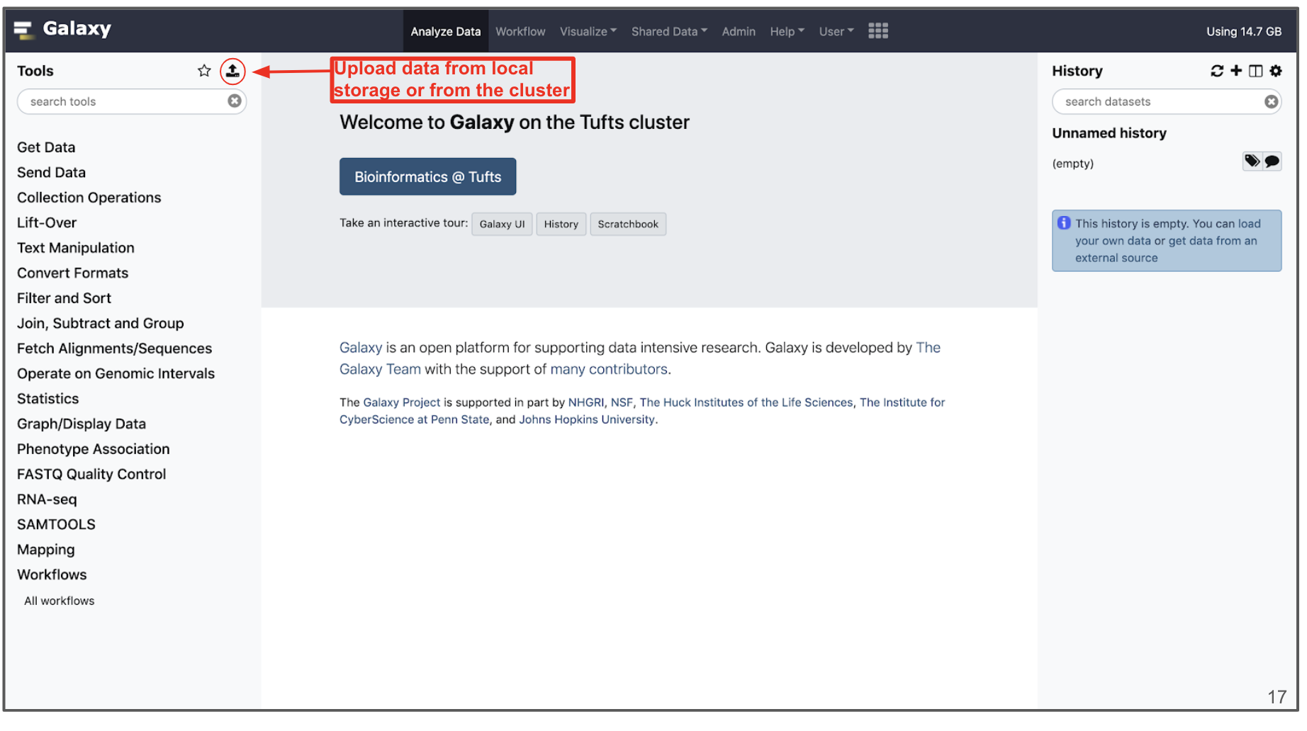
Importing data
Notes:
Data can be uploaded to Galaxy in a number of ways by clisking the “Upload” icon on the top of the Tools panel.

Slide 22
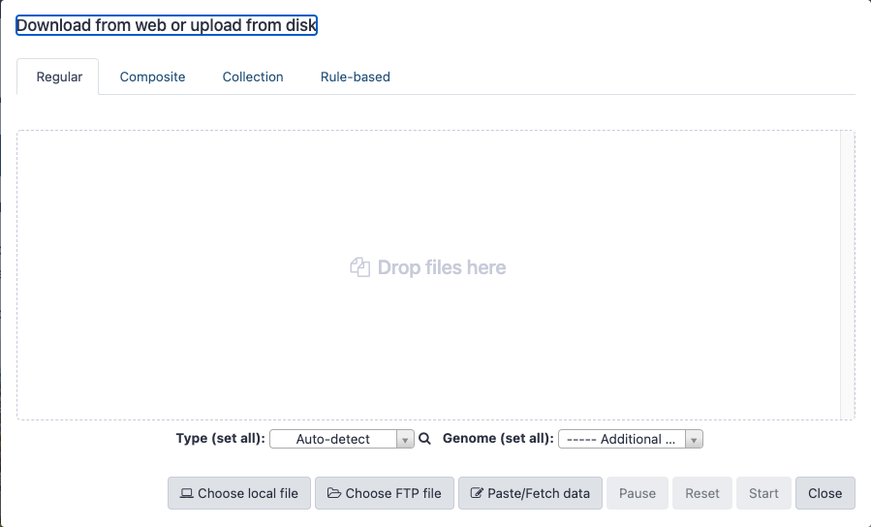
Importing data
Cluster directory
/cluster/tufts/galaxy/xfer/username
From Computer
Internet
Notes:
Data can be uploaded to Galaxy in a number of ways by clisking the “Upload” icon on the top of the Tools panel.

Slide 23
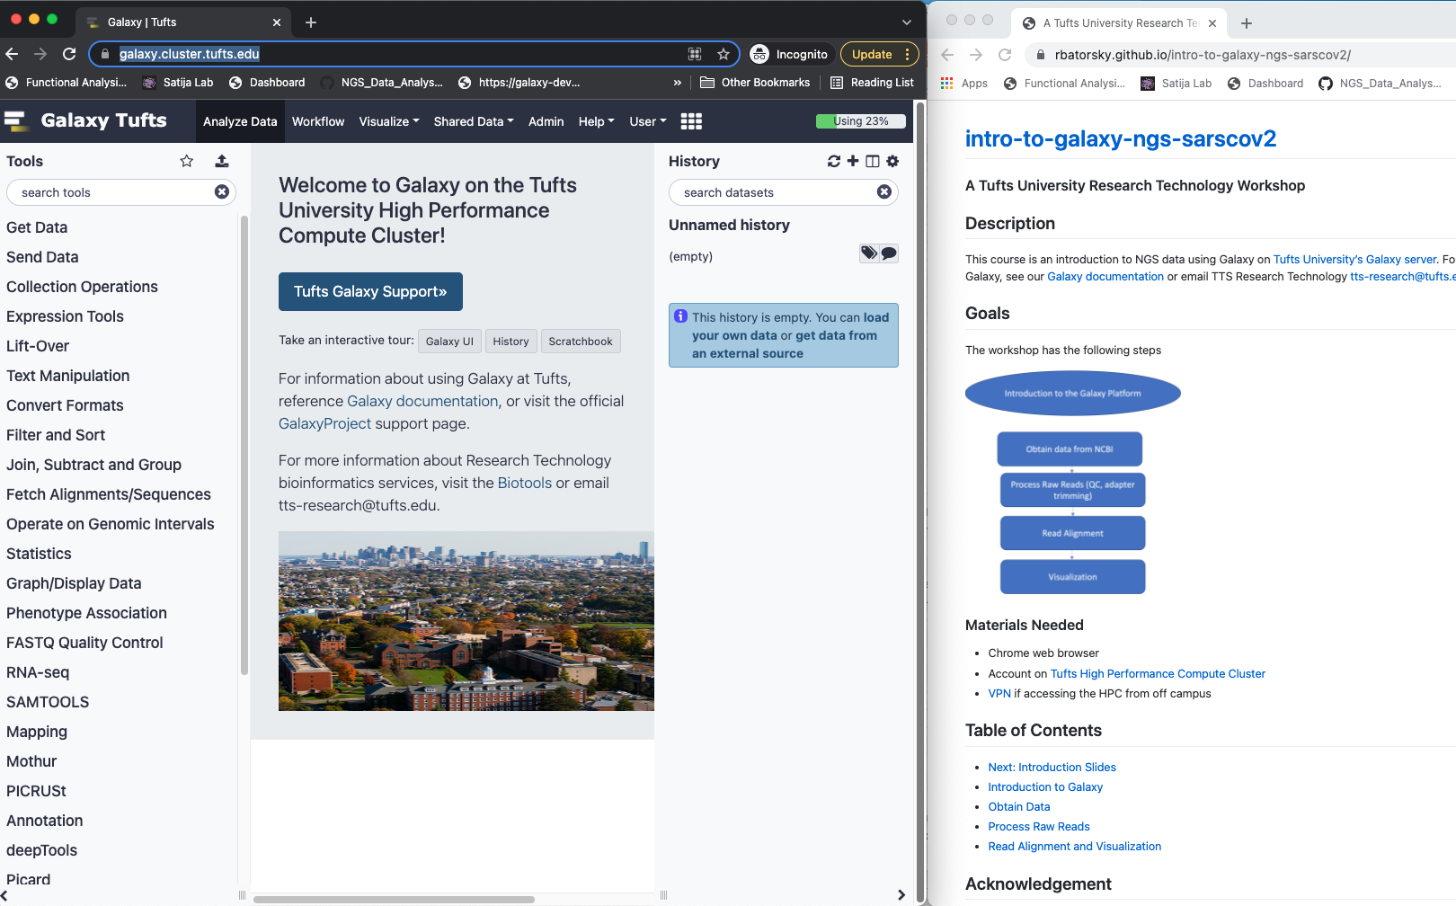
Log into Galaxy and open course website
Connect to Tufts Network, either on campus or via VPN
Visit https://galaxy.cluster.tufts.edu
Log in with you Tufts credentials
Visit course website https://rbatorsky.github.io/intro-to-galaxy-ngs-sarscov2
Navigate to Obtain_Data section

Slide 24
Outline
Introduction to the Galaxy Platform
Obtain data from NCBI
SARS-Cov-2 Alpha variant reference sequence
SARS-Cov-2 Delta variant NGS sample
Process Raw Reads (QC, adapter trimming)
Read Alignment
Visualization

Slide 25
NGS details

Slide 26
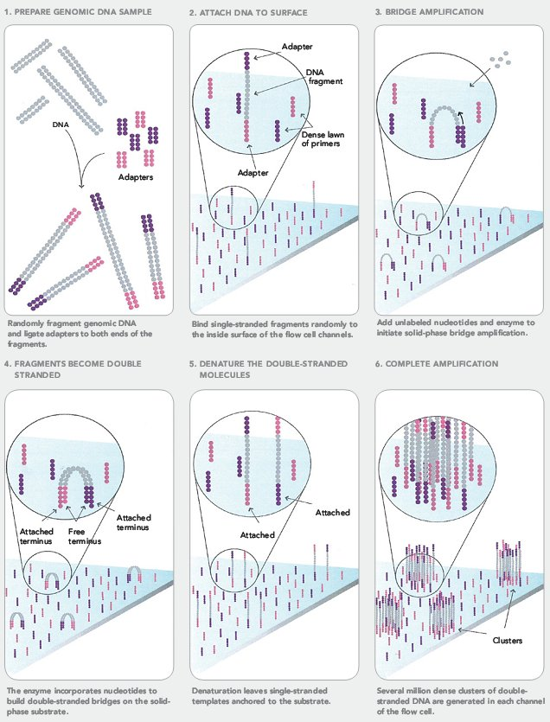
Next Generation Sequencing (NGS)
https://sites.google.com/site/himbcorelab/illumina_sequencing

Slide 27
Next Generation Sequencing (NGS)
https://sites.google.com/site/himbcorelab/illumina_sequencing

Slide 28
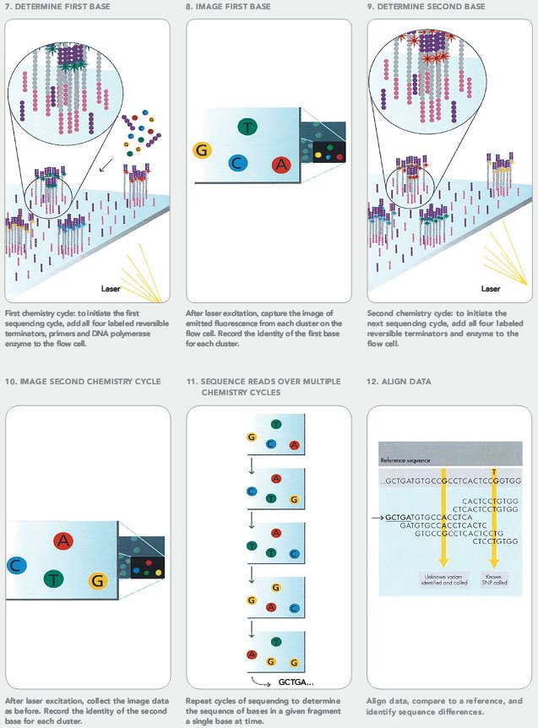
Next Generation Sequencing (NGS)
https://sites.google.com/site/himbcorelab/illumina_sequencing

Slide 29
Next Generation Sequencing (NGS)
This Illumina video is great for visualization!
https://sites.google.com/site/himbcorelab/illumina_sequencing

